Slide 1
History of jat.attitude
Noriko Takada
April, 2004

Slide 2
How I started…
Need of Thesis Topics
Interest in Attitude Dynamics
  Continue with what was learned in classes
Daniel Quock
  Attitude Simulation Applet from ground-up
  Left tasks…
    On-line debut
    More Scenarios

Slide 3
Daniel Quock- my predecessor
Developed Runge Kutta 4th order numerical integration routine
Developed means of 2D & 3D visualization
Developed three scenarios
  Constant, Body-Fixed Torques
  Three Reaction Wheels, Actively Controlled Spacecraft
  Gravity Gradient

Slide 4
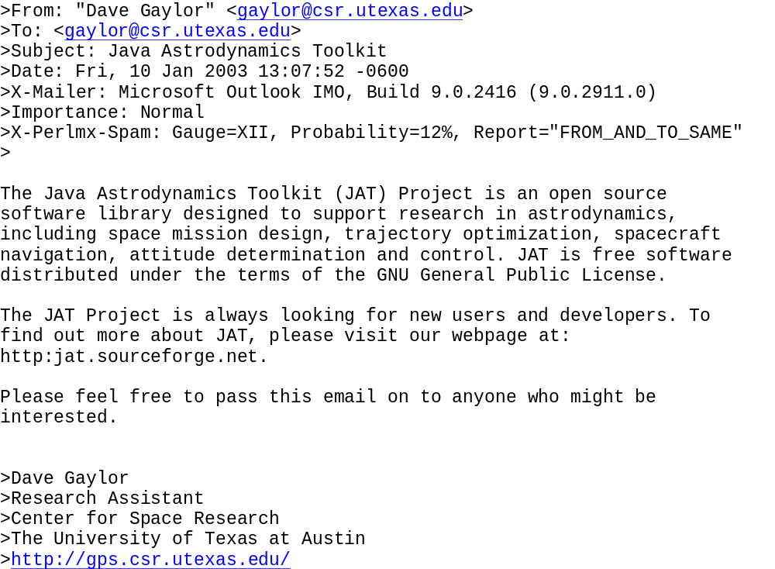
First Point of Contact

Slide 5
What I have done…
Added attitude dynamics scenarios
Developed Attitude Simulation Applet
Made the applet accessible on-line
Derived flexible-spacecraft EOMs
Developed 3D visualization for flexible-body dynamics

Slide 6
Added more scenarios
Constant Torque
Gravity Gradient, circular orbit
Gravity Gradient, eccentric orbit
Spherical Damper
Reaction Wheel maneuver
CMG maneuver
1-axis Bang-Bang
Simple 2-D flexible SC
Simple 3-D flexible SC

Slide 7
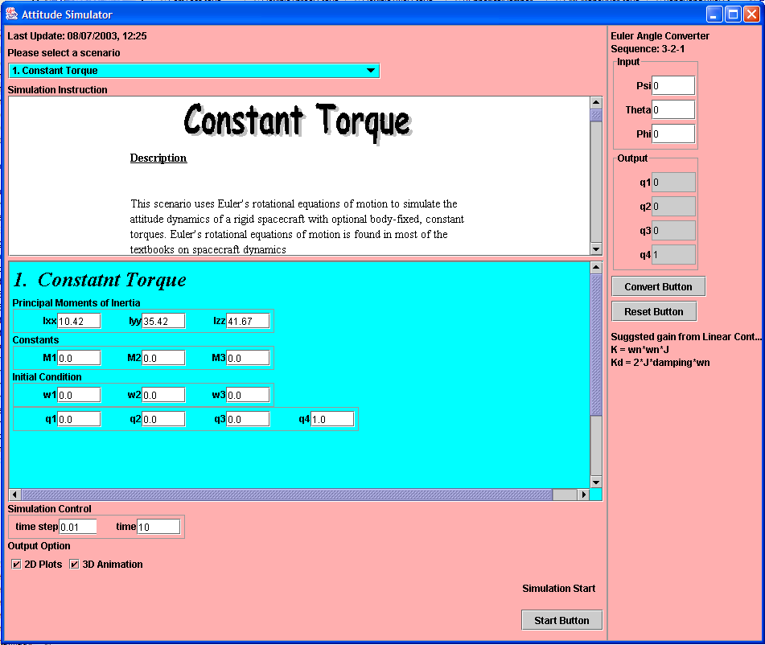
Developed Simulation Applet
(11) Converts Euler angles to Quaternions
(1) Choose Scenario
(2) Help File
(3) Moments of inertia
(4) Constants
(5) Initial Condition
(6) Numerical Integration Control
(7) Simulation Time
(seconds) or (orbits)
(8) 2D Plots
(9) 3D Animation
(10) Start!!

Slide 8
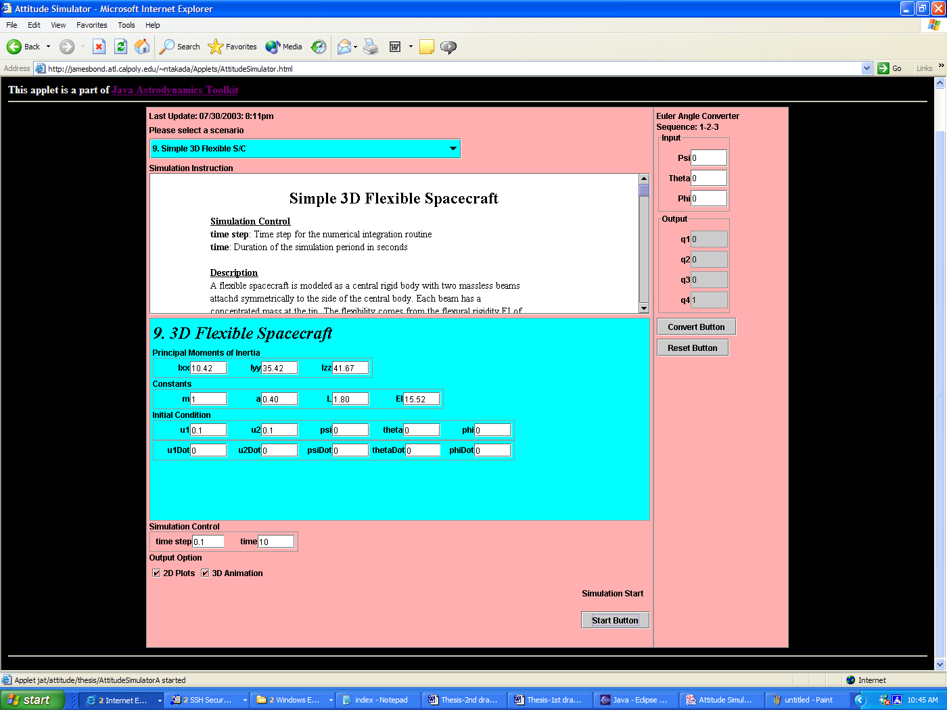
Made the applet accessible
http://jamesbond.atl.calpoly.edu/~ntakada/Applets/AttitudeSimulator.html

Slide 9
Derived Flexible SC EOMs
Used Energy Method
Used Maple to Solve for a Set of EOMs
Incorporated Flexibility as beam appendages
Validated EOMs by the Conservation of Angular Momentum

Slide 10
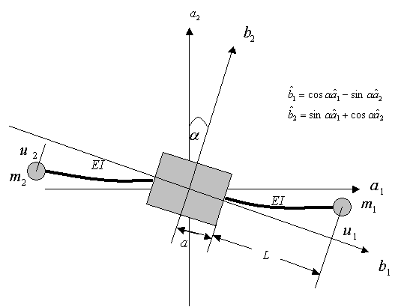
Flexible SC Model Used

Slide 11
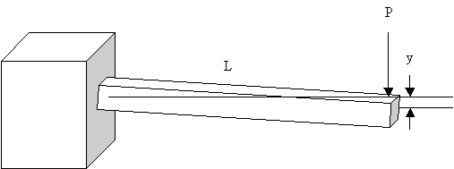
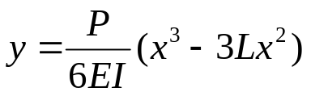
Incorporation of Flexibility

Slide 12
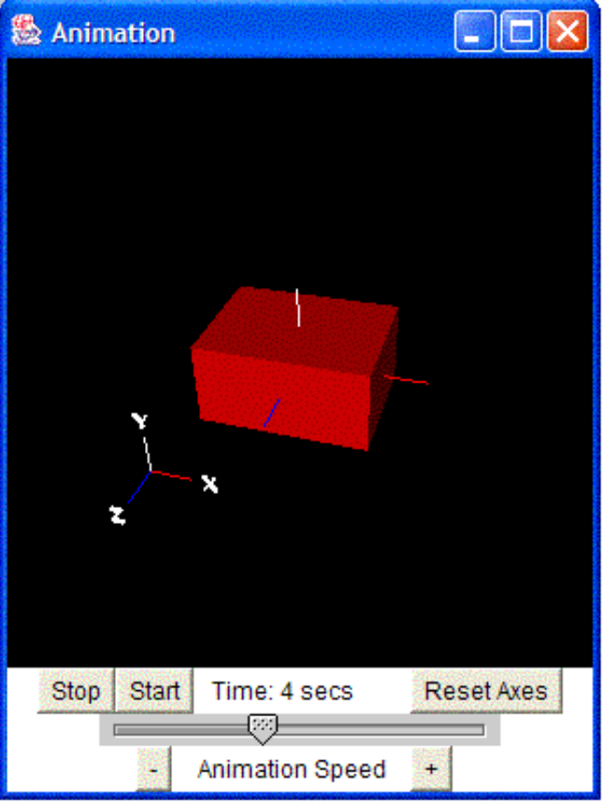
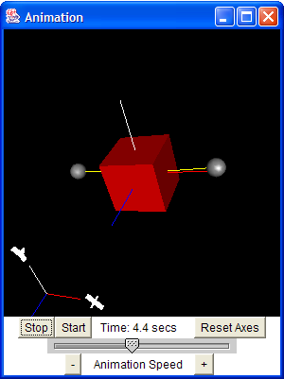
3D Visualization for Flexible SC

Slide 13
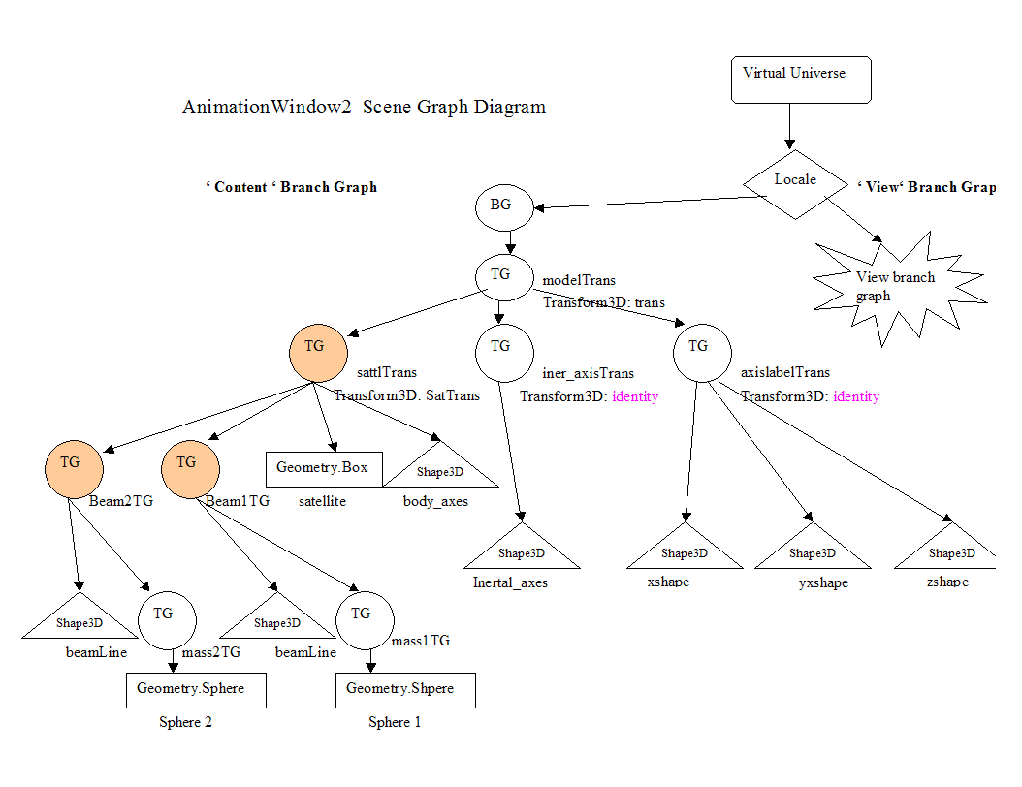
3D Flex SC Inner Workings
Notes:
In Java3D, connection between two objects is represented by TransforGroup (TG). TG has its own representation of transformation with respect to TG at the next higher level to which it is connected.

Slide 14
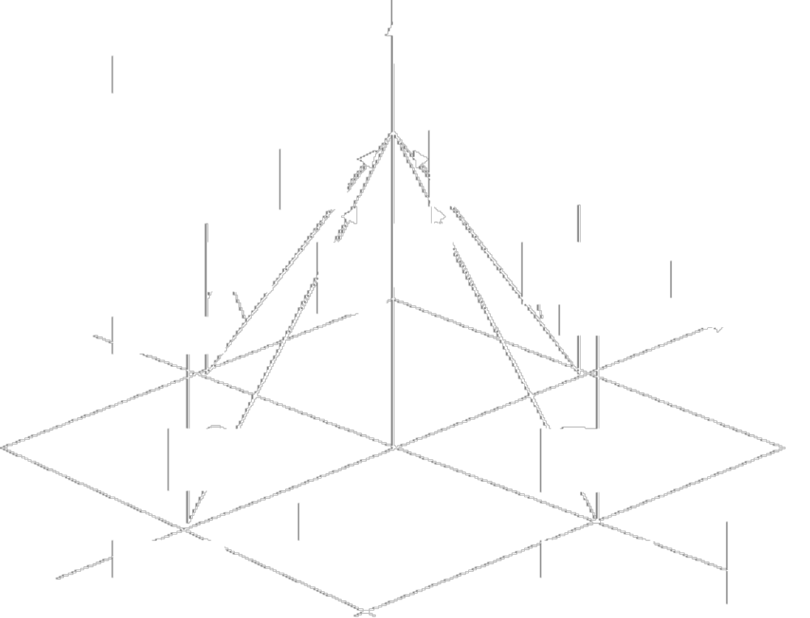
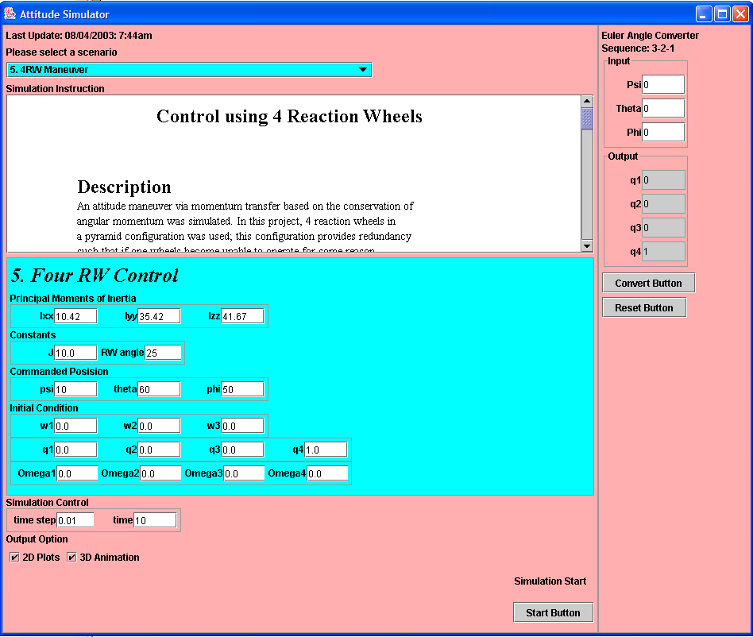
Demo 1: Four Reaction Wheel

Slide 15
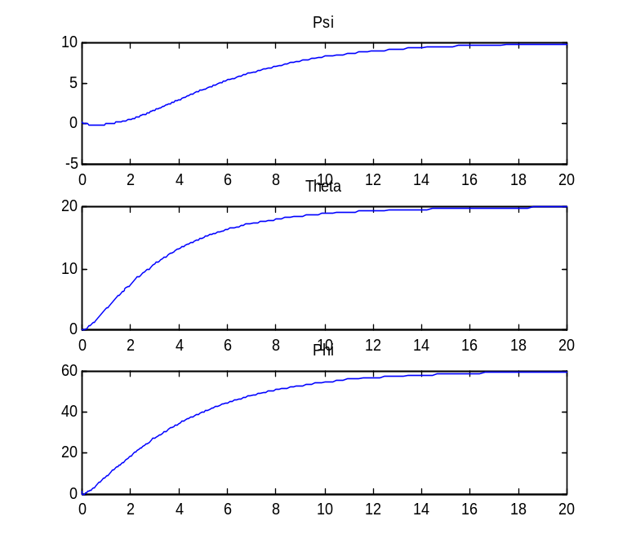
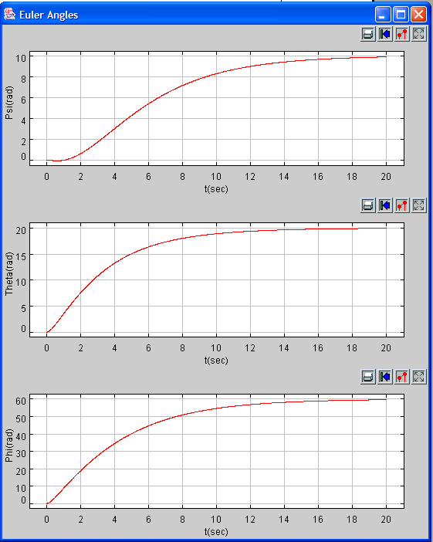
Four Reaction Wheels in action -1

Slide 16
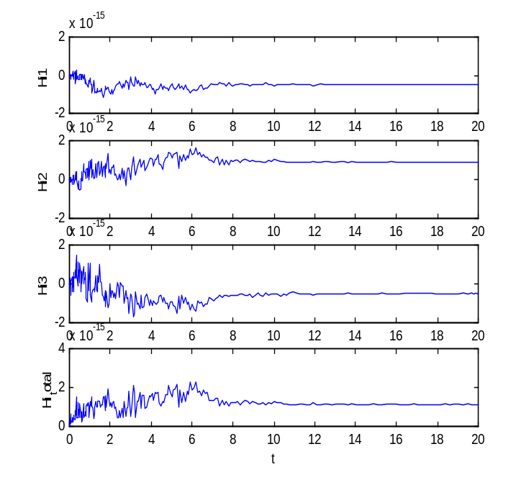
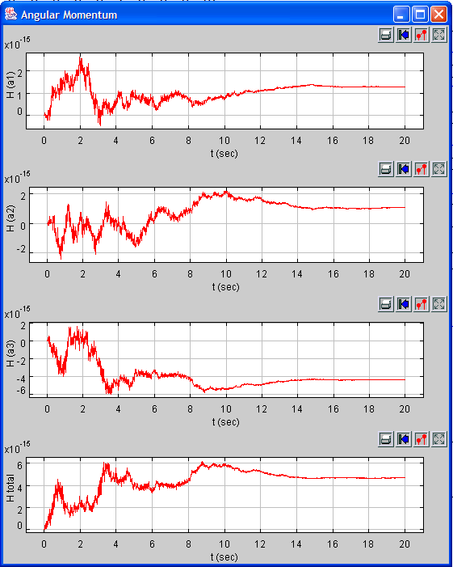
Four Reaction Wheels in action-2

Slide 17
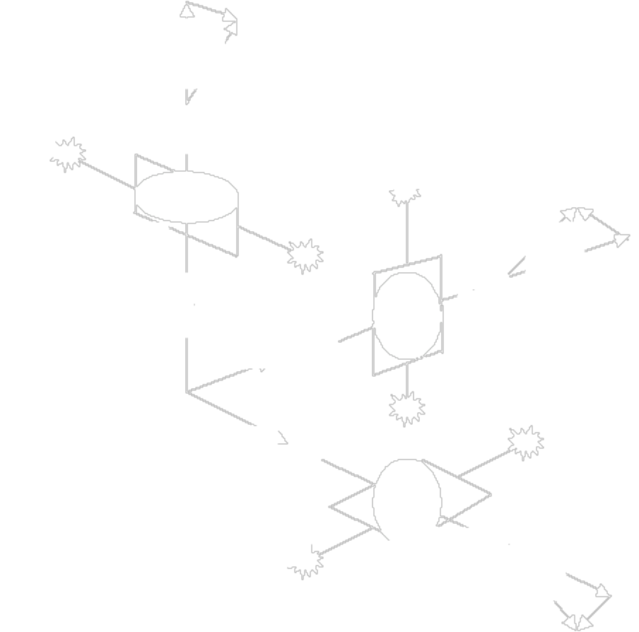
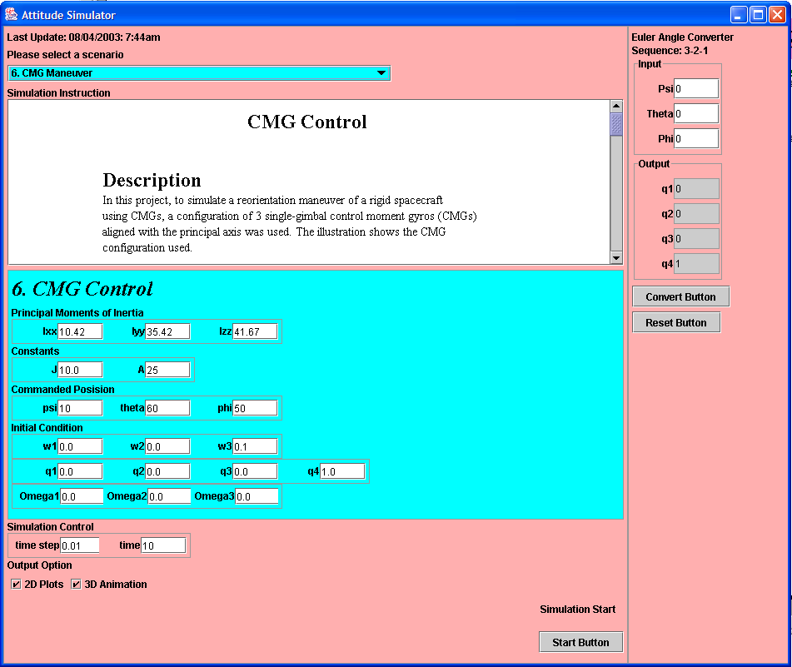
Demo 2: Three CMGs

Slide 18
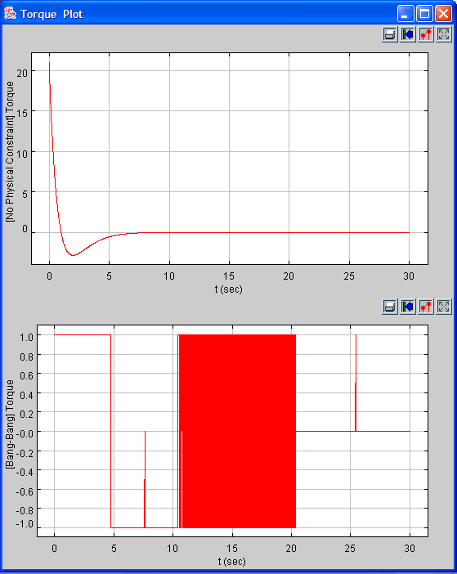
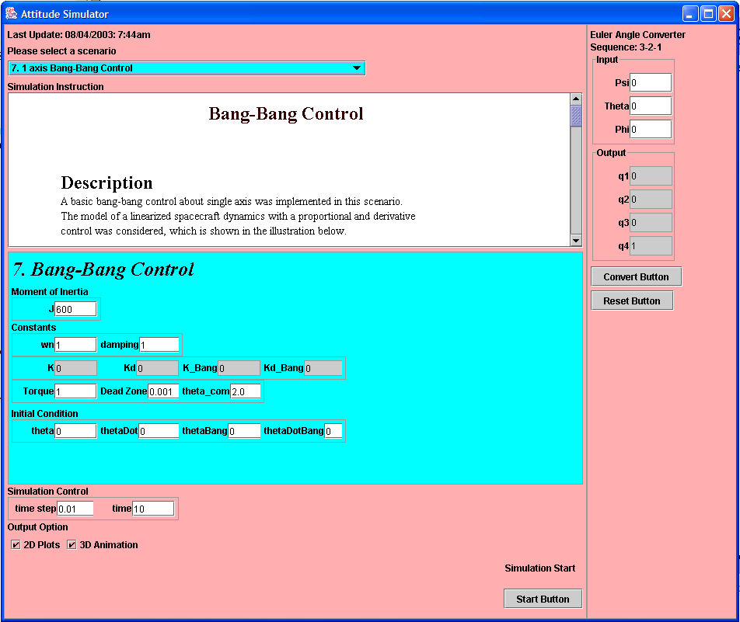
Demo 2: Bang Bang Control

Slide 19
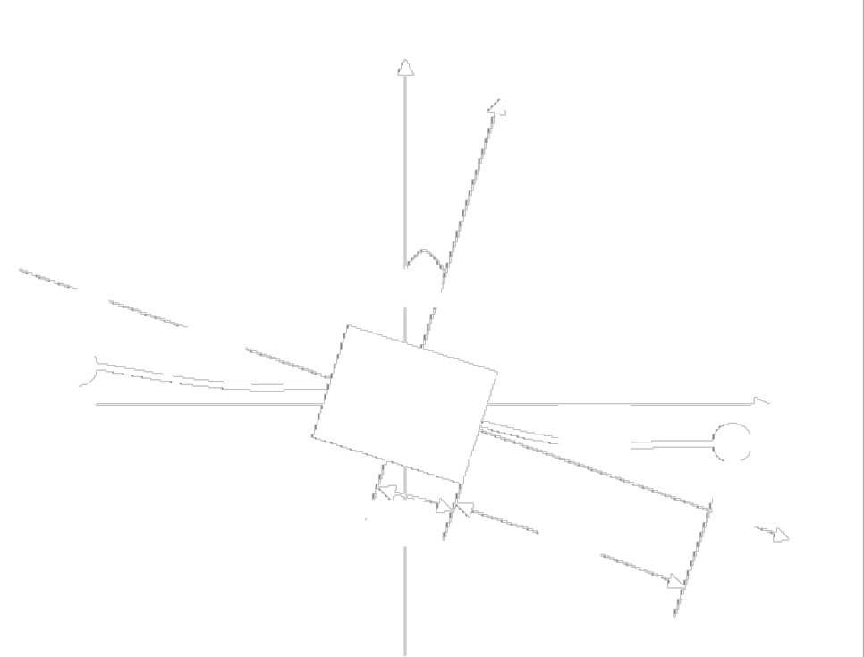
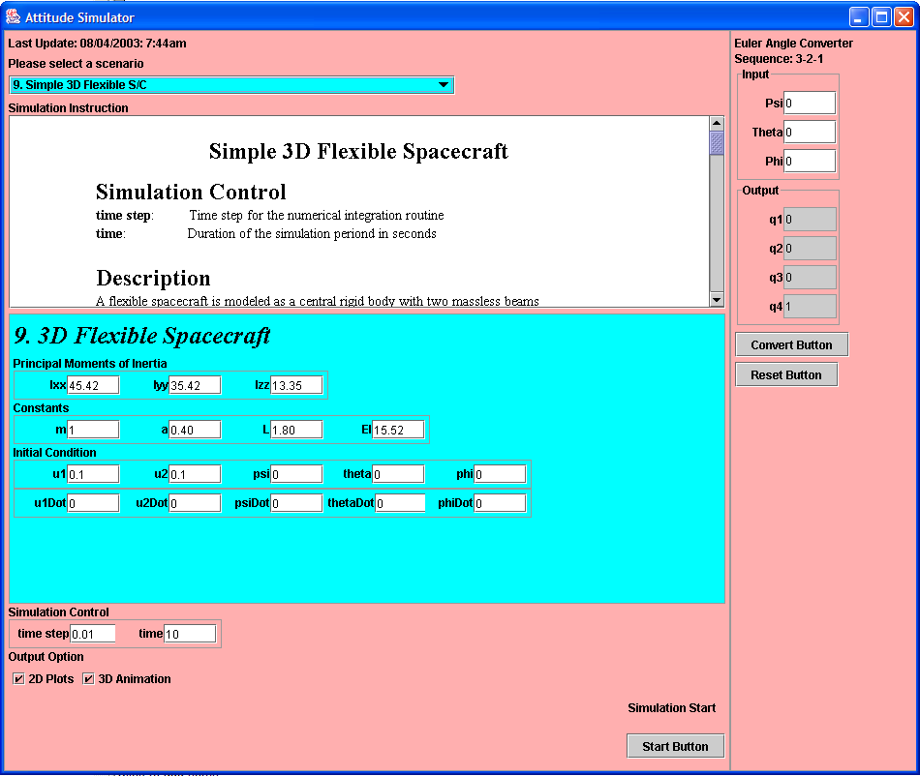
Demo 3- Flexible SC

Slide 20

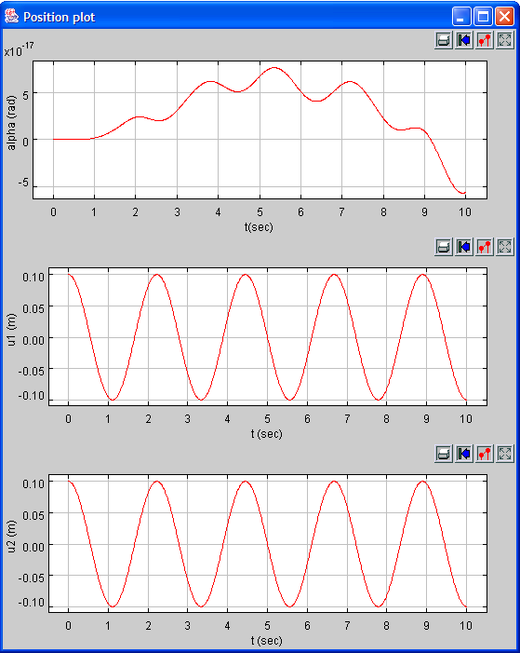
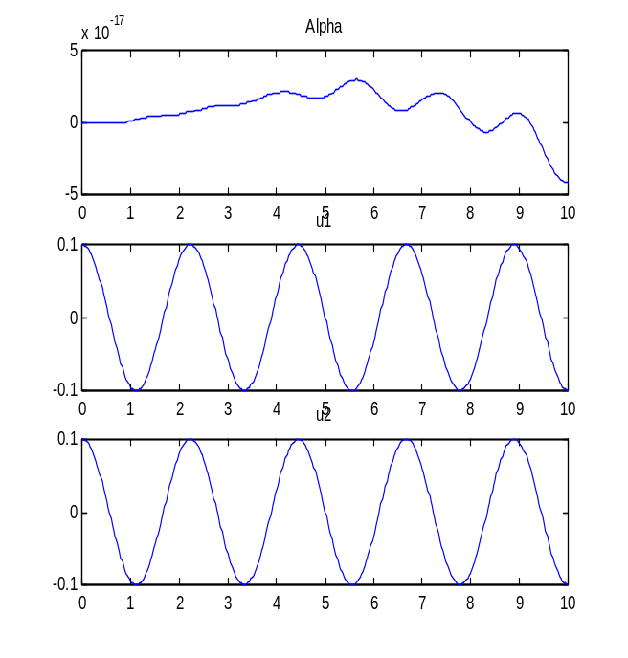
Flexible SC in action-1
Position Plot for a symmetric initial condition

Slide 21

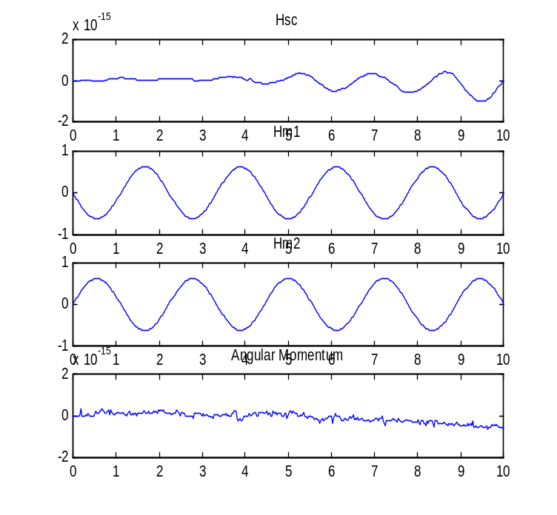
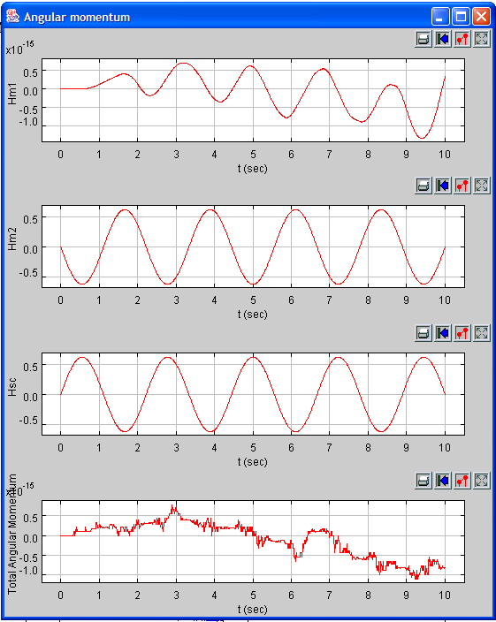
Flexible SC in action -2
Angular Momentum Plot for a symmetric initial condition

Slide 22

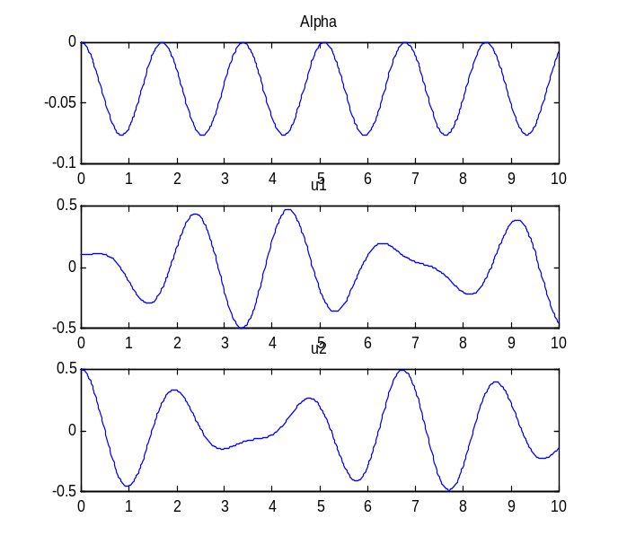
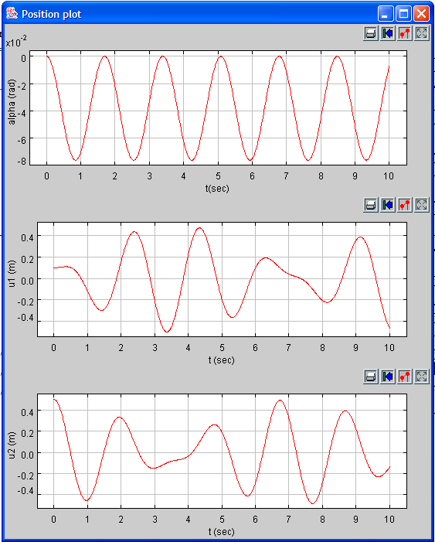
Flexible SC in action- 3
Position Plot for a non-symmetric initial condition

